Slide 1

Response Curves and Action Inertia in Utility-Based NPC AI
An experimental study of behavioral stability
Wenjie Jiang
M.S. Computer Science, Cal State LA
Advisor: Dr. Navid Amini
April 2026

Slide 2
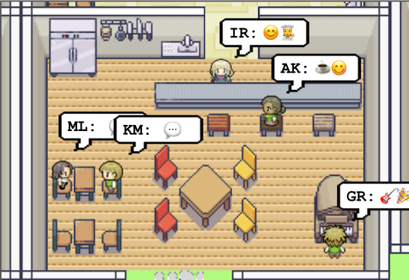
The Overall Project Scope and Objectives
Project Scope
Platform: Offline 2D domestic simulation in Unity
Architecture: Decentralized "Pull/Scanner" system (proactive agents)
Comparison: Utility-based (Fluid) vs. Threshold-based (Rigid) Agents
Context: Low-stakes, "slice-of-life" daily routines
Objectives
Realism: Achieve "AI Town" style behavior using lightweight math (no LLMs)
Stability: Quantify and reduce "Behavioral Jitter" (Action Thrashing)
Autonomy: Show emergent adaptability to removed/obstructed resources
Scalability: Extensible framework via ScriptableObject architecture

Slide 3
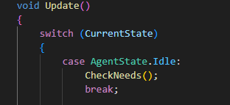
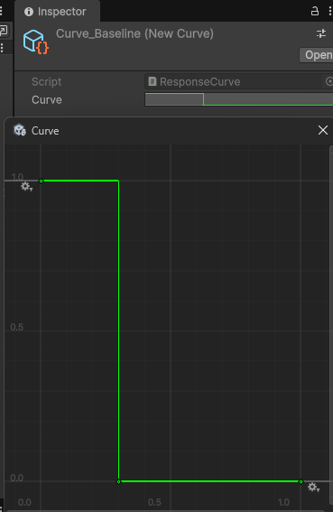


Proposed Methodology and Technical Approach
1. Pull-based Perception
Proactive Agents: Instead of objects "broadcasting" to the agent, the agent actively scans the world
2. Mathematical Decision Brain
Utility Scoring: Uses Non-linear Gradients (S-curves) to map need levels to action desire
Normalization: All inputs (Hunger, Energy) are mapped to a 0.0 - 1.0 scale for fair comparison
Action Inertia: A mathematical weight added to the current task to ensure commitment and prevent jitter
3. ScriptableObject-Driven Framework
Architectural Decoupling: Behavioral data (Needs, Curves) and Object data are stored as assets, not hard-coded in C#
Extensibility: New interactions (e.g., Computer, TV) are added by creating new data files, requiring zero code refactoring

Slide 4
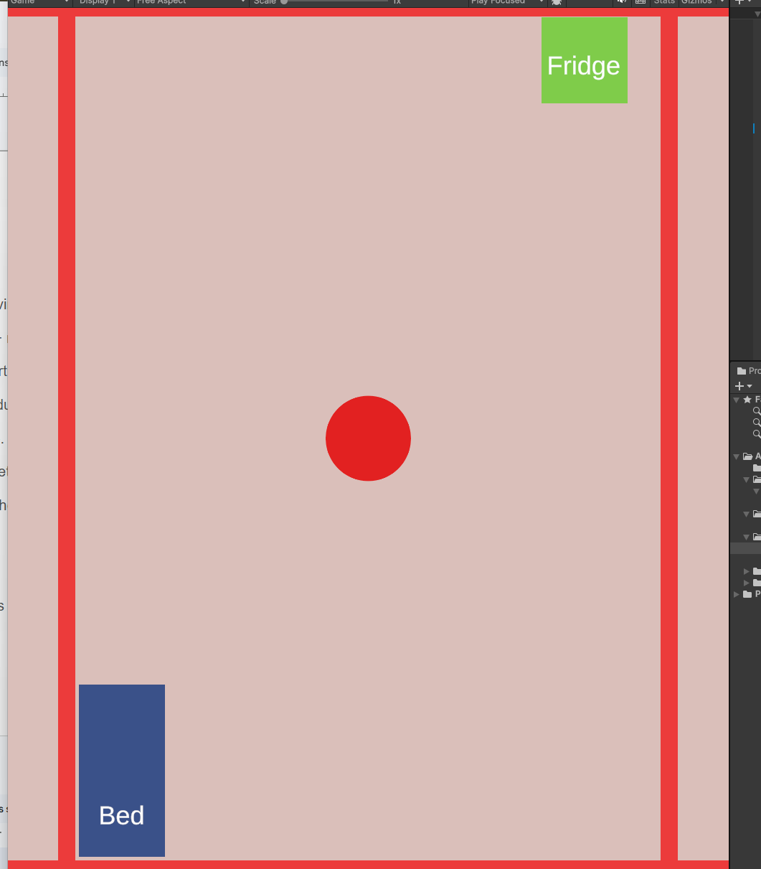


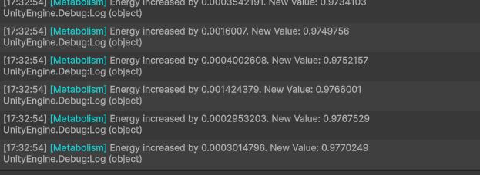
Expected Challenges and Risks
Environmental Scalability (Pathfinding): Currently, the agent operates in a single-room "Greybox." A major challenge will be ensuring robust navigation as the map scales to a multi-room house with complex obstacles (e.g., doors, corridors, and furniture)
Behavioral Commitment vs.Survival: Balancing "Action Inertia" to prevent behavioral jitter while ensuring agents can interrupt long-duration tasks (like sleeping) to respond to survival emergencies (like starvation)
Systemic Parameter Equilibrium: Finding the "Mathematical Equilibrium" for decay and restoration rates. The challenge is balancing these numbers so that agents have time for "peaceful" life routines rather than being stuck in a perpetual survival loop
Data Instrumentation & Logging: Current debug log outputs are insufficient for academic proof. A key challenge is building a structured Data Pipeline to export high-frequency decision logs (CSV) for quantitative analysis and visualization

Slide 5


Review of Existing Work in this Area
Scripted Schedules (Stardew Valley): Stardew Valley represents the gold standard for traditional scripted schedules. By using hand-authored paths, it creates a deeply immersive narrative atmosphere where players learn the daily habits of every NPC. Our project takes inspiration from this sense of a "living world," but aims to study how we can move from these pre-planned schedules into a system where routines emerge autonomously from the agent's internal needs.
Broadcasting/Push Systems (The Sims 4): The Sims pioneered the "Smart Object" pattern, which remains the standard for scalable environmental interaction by decoupling object data from agent logic. While our project adopts this data-driven philosophy using ScriptableObjects, it evaluates a key research variation: shifting from a "broadcasting" (push) model to a proactive "scanner" (pull) model to investigate its impact on decision-making stability and reducing behavioral jitter.

Slide 6
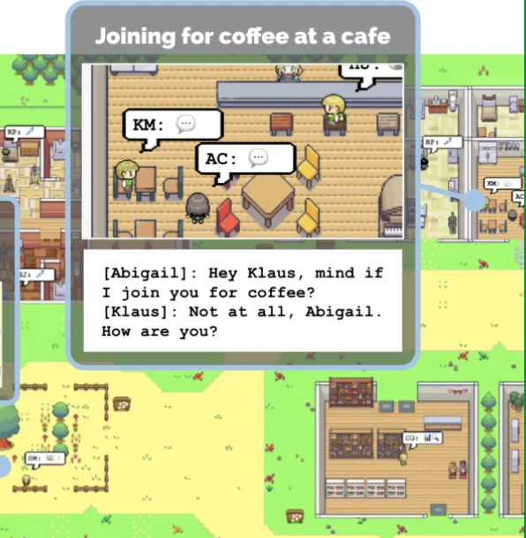

Believable Realism (Stanford’s AI Town): The research behind AI Town proved that high-level social realism and "alive" NPC routines are possible and highly engaging. It set a new benchmark for what a believable digital society looks like. Inspired by this vision of organic routines, our project aims to build a lightweight, offline form of this realism. We are studying if smart mathematical curves can achieve that same "alive" feeling locally without the heavy cost of LLMs.
Utility System Core (RimWorld): RimWorld is the technical pinnacle of systemic emergence, utilizing a proactive "Scanner" architecture and Utility Theory to allow agents to autonomously evaluate their world. This framework serves as the core technical inspiration for my project. My research focuses on the specific balancing and tuning required to apply this robust survival-centric logic to low-stakes, peaceful domestic routines.

Slide 7
How Our Approach Addresses Limitations of Existing Models
Finding the "Middle Ground":
Environmental Adaptability: Replacing rigid schedules with proactive "Scanning." Agents autonomously recalculate routines in real-time if paths are blocked or resources are moved
Behavioral Stability: Reducing the "Action Lock-in" and "Jitter" problems. By implementing Action Inertia, agents remain focused on routines but retain the mathematical flexibility to interrupt a task for survival emergencies
Lightweight Realism: Achieving "AI Town" style believable routines using local Non-linear Math Curves instead of expensive cloud-based Generative Models (LLMs)

Slide 8
Potential Improvements over Current Techniques
Computational Efficiency: Achieving believable, high-level routines locally with near-zero CPU overhead compared to cloud-based LLMs
Environmental Resilience: Robust architecture that agents autonomously adapt to moved or obstructed resources without logic failure
Designer Flexibility: Rapid iteration of NPC "personalities" via ScriptableObject assets (Curves) without code refactoring
Behavioral Continuity: Reduce "robotic jitter" through mathematical inertia and task commitment

Slide 9
A Tentative Timeline for Completion
January: Infrastructure & Data Design (Completed)
  Established Git workflow and the core ScriptableObject architecture for Needs and Smart Object data
February: The Simulation Loop (In progress)
  Constructed the greybox environment with metabolism decay, physics-based movement, and incremental restoration
March: Baseline Agent
  Finalizing threshold-based logic to establish a stable, autonomous survival loop for the control group
April: Data Logging & Preparation
  Developing a CSV export pipeline for quantitative analysis and integrating AnimationCurve structures for the Utility transition.
May: Evaluation & Documentation
  Conducting long-duration stability testing and finalizing the semester progress report

